Slide 1

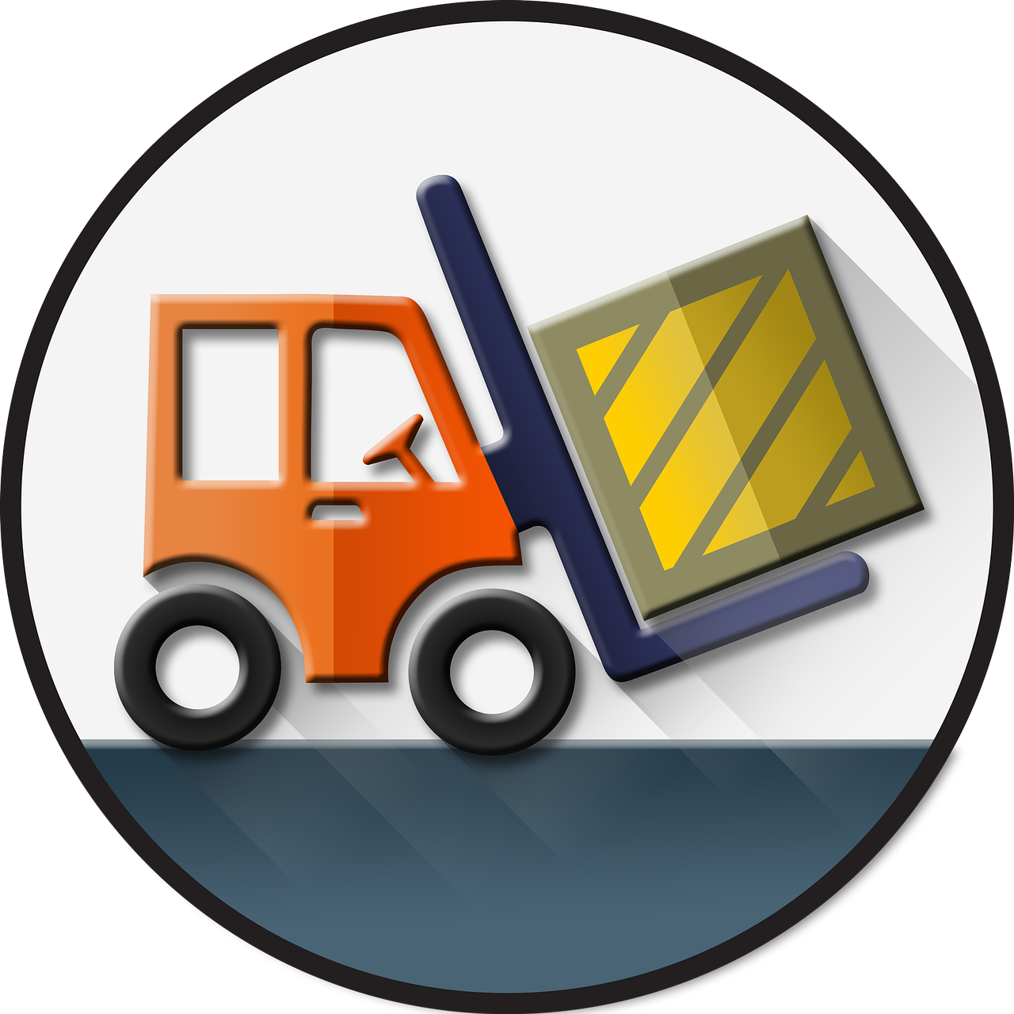

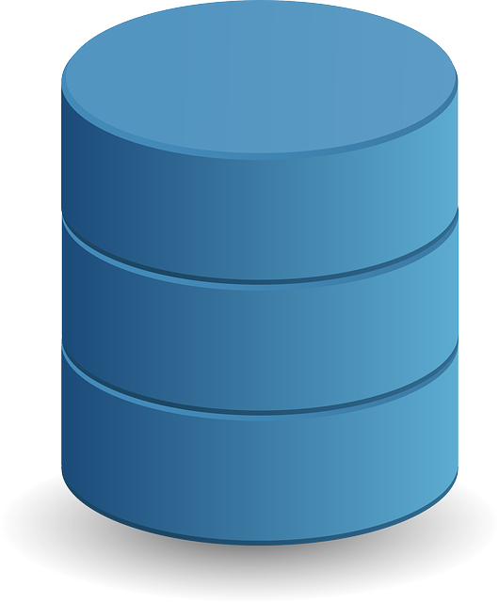




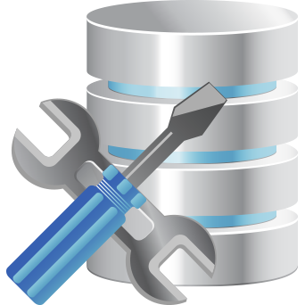
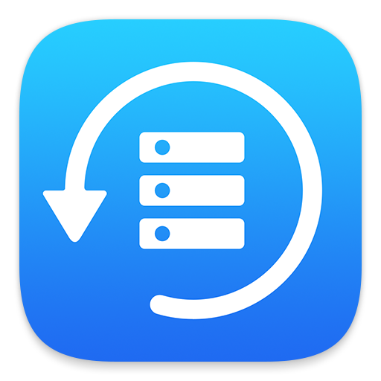

Relational Databases are the heart of your most critical applications
But they can become difficult to manage and operate with high availability as you scale your app
Monitoring & Performance Tuning
Installs
Patching
Backups
Scaling
Security
Storage Management
Hardware Upgrades
Database administration is resource-intensive
Taking time away from building your application

Slide 2


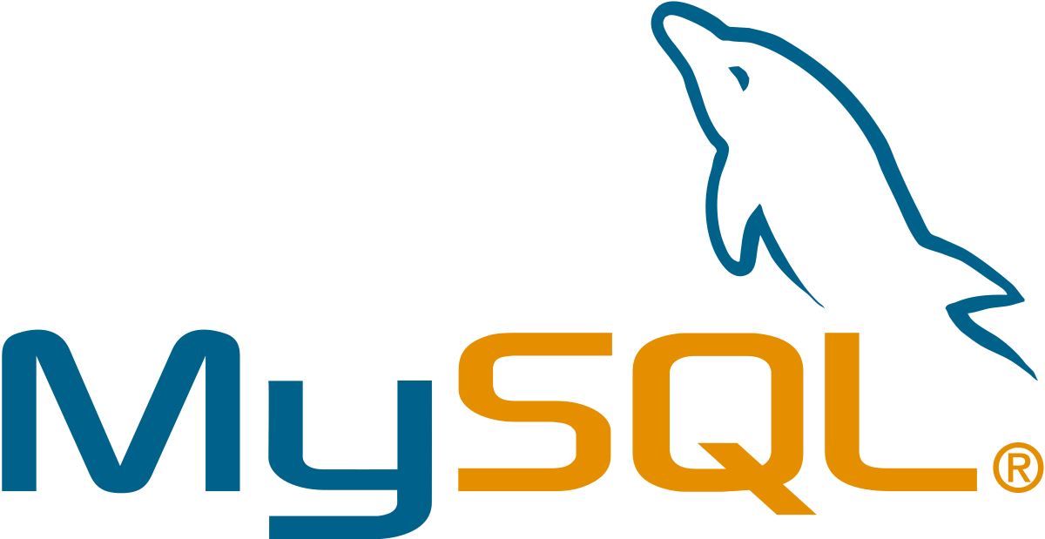
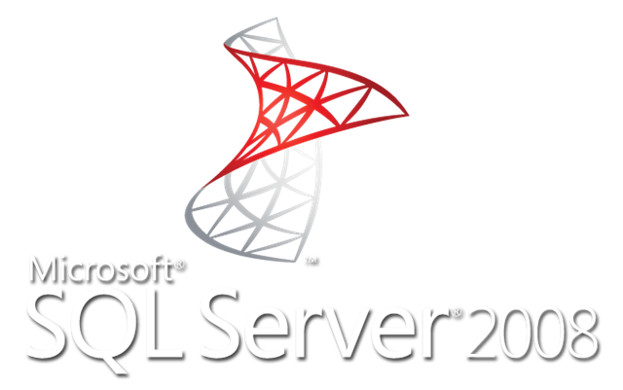
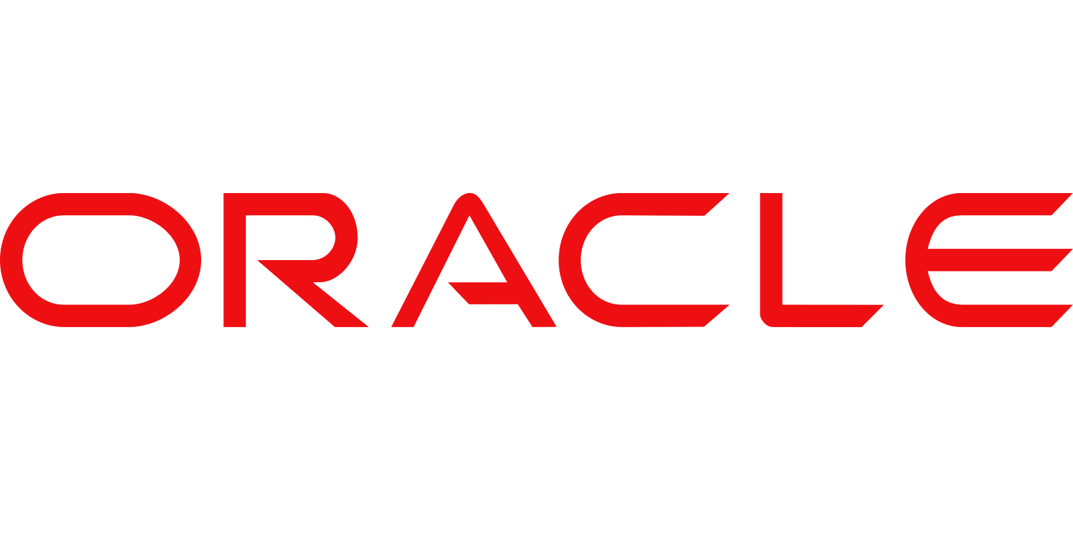
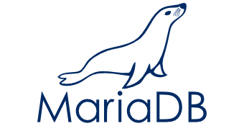
Amazon Relational Database Service (RDS) simplifies database management by automating time-consuming administration tasks
With less operational overhead, your team can focus on optimising applications and getting faster results
Amazon RDS gives you the freedom to use your relational database of choice
Including the most popular open source
And commercial engines

Slide 3

And Amazon’s relational database built for the cloud
Amazon Aurora
Aurora is MySQL and PostgreSQL compatible and offers the performance and availability of traditional commercial databases at a fraction of the cost

Slide 4
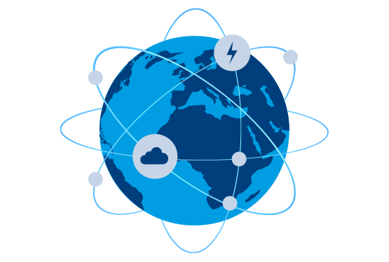
RDS allows you to scale across a global footprint of data centres with enterprise high-availability and disaster recovery, no matter your size

Slide 5
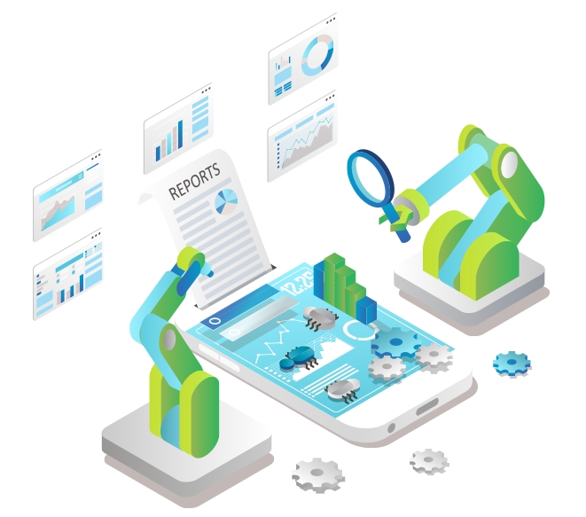
RDS automates many previously cumbersome tasks

Slide 6
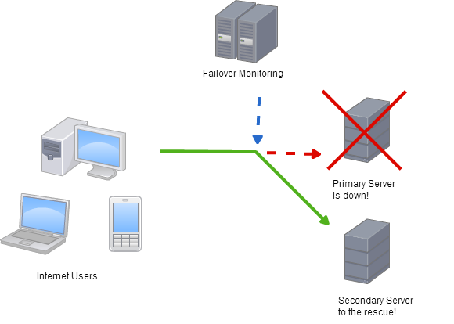
Automatic Failover

Slide 7
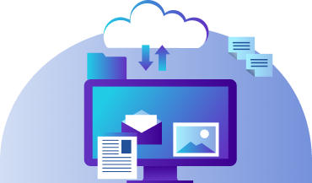
Backups and Point-In-Time Restore

Slide 8
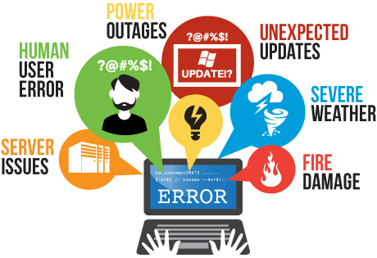
Disaster Recovery

Slide 9
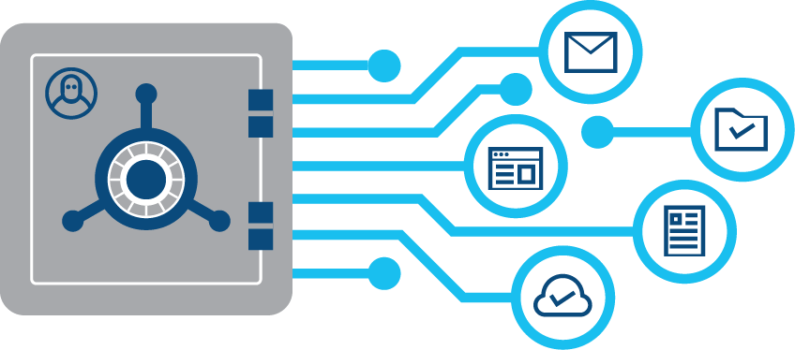
Access Management

Slide 10

Encryption

Slide 11

Secure Networking

Slide 12

Monitoring

Slide 13

Performance Optimisation

Slide 14

All these and more can be enabled with a few clicks or API calls

Slide 15


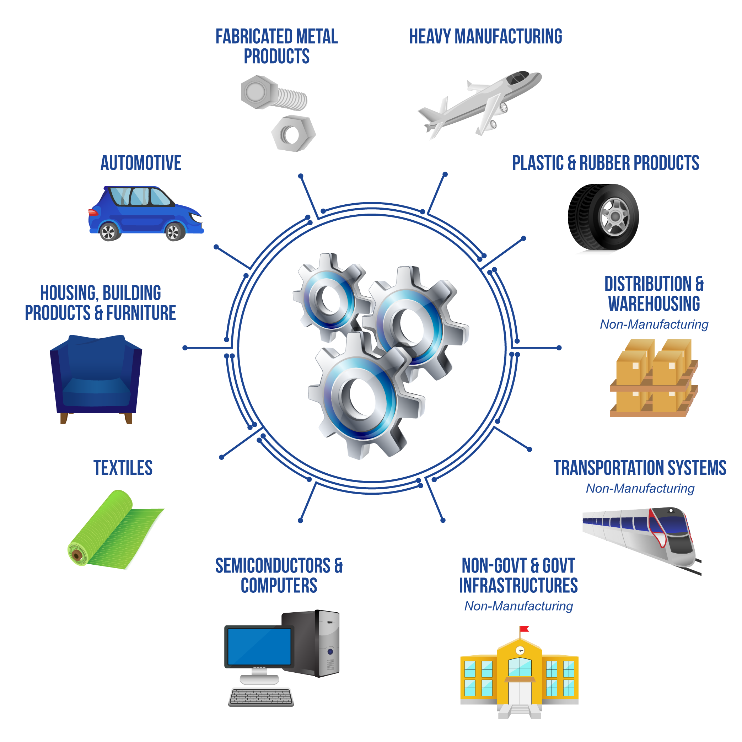

Even highly regulated industries can leverage RDS

Slide 16
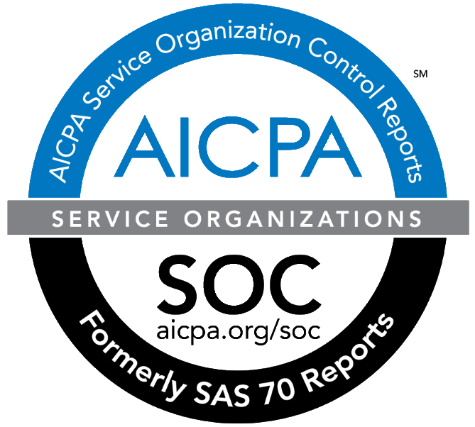






Which meets a broad range of compliance certifications

Slide 17




Hundreds of thousands of AWS customers use Amazon RDS today

Slide 18
RDS Benefits
Easy to administer
Highly scalable
Available and durable
Fast
Secure
Inexpensive

Slide 19

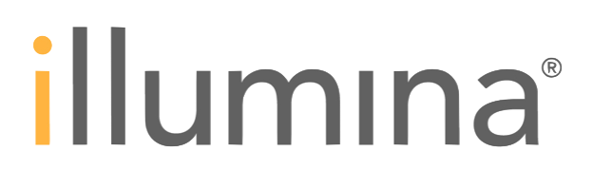





Featured RDS Customers

Slide 20
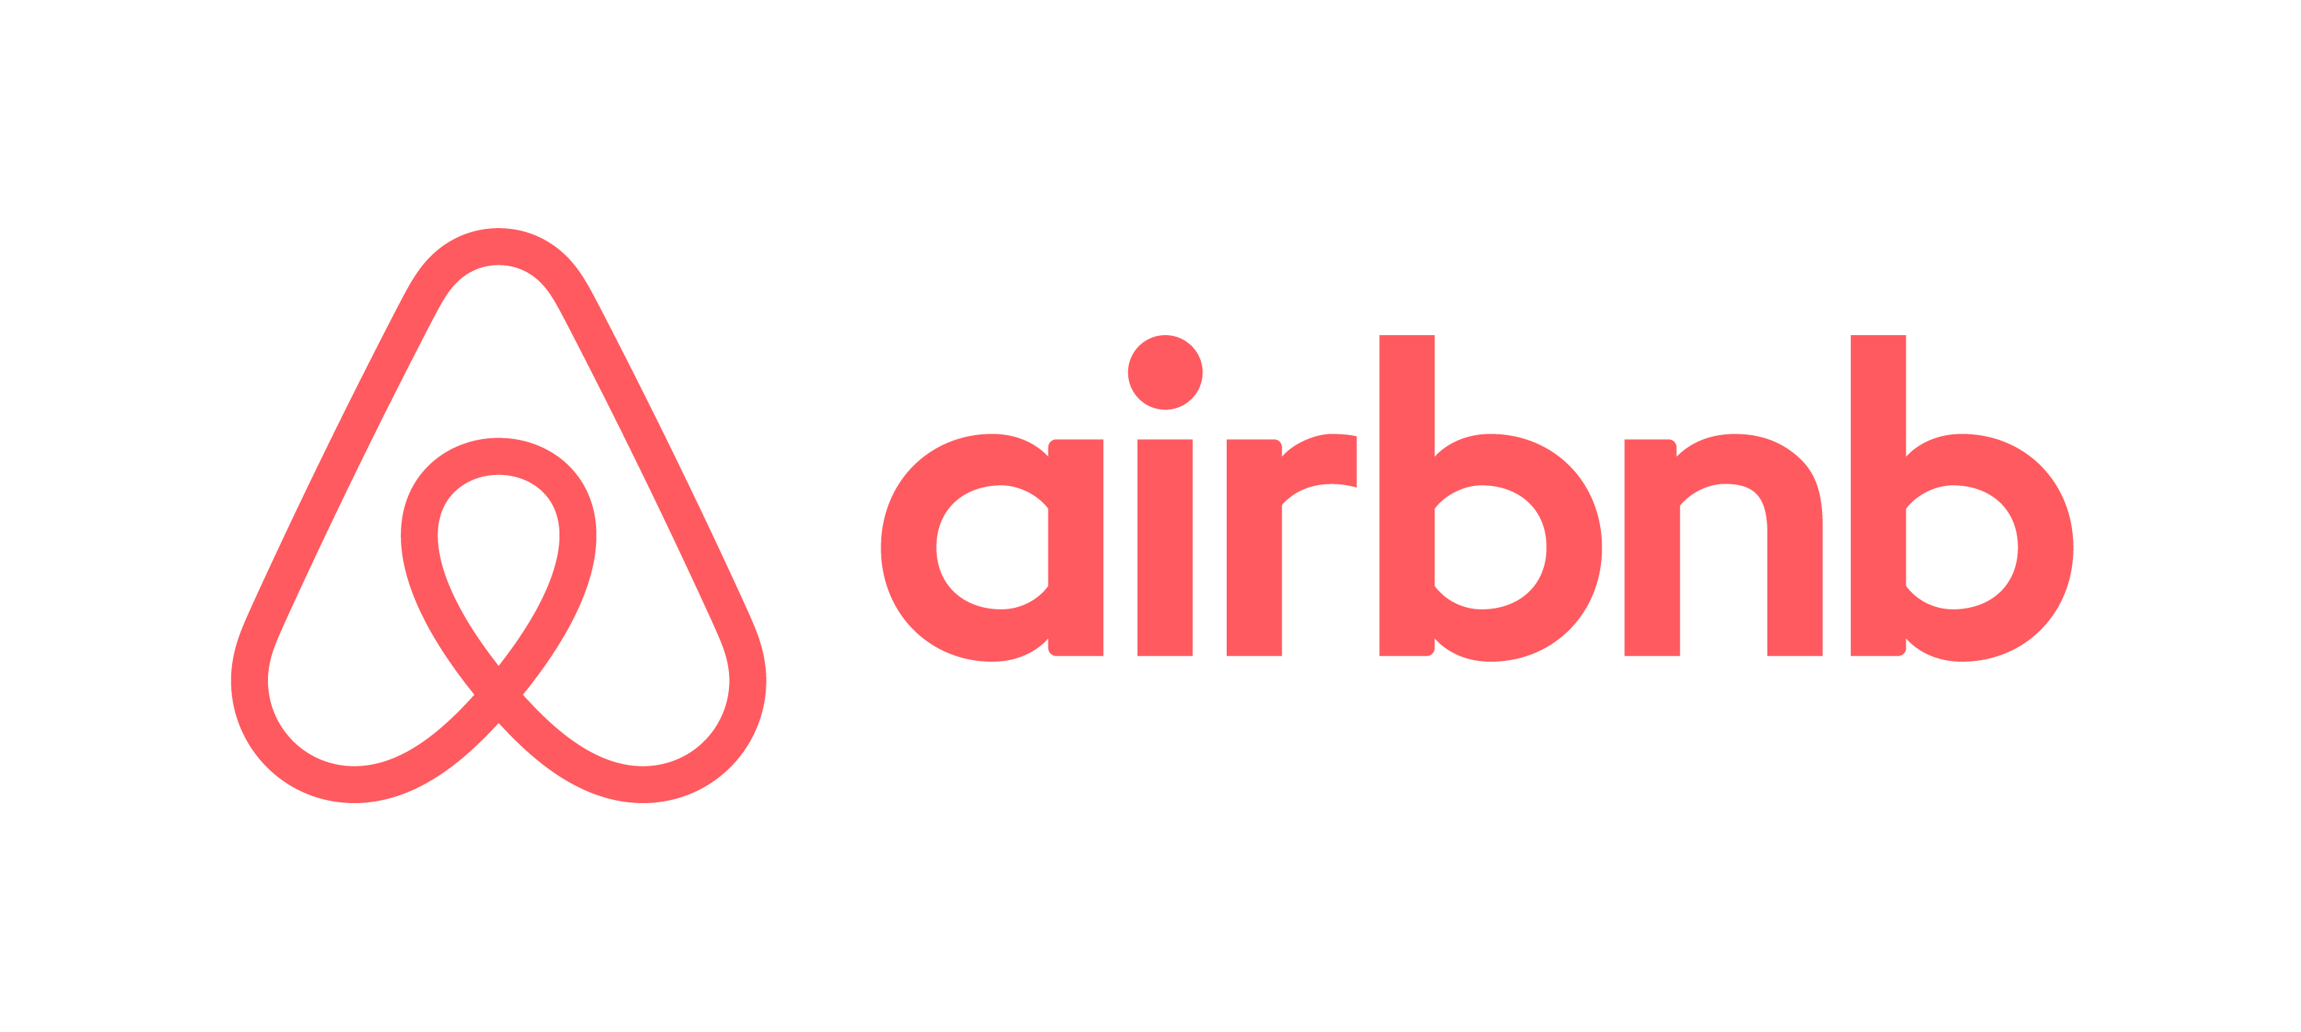
RDS Use Cases
Web and mobile applications
Web and mobile applications that are built to operate at very large scale
need a database with high throughput, massive storage scalability, and
high availability. Amazon RDS fulfils the needs of such highly demanding
applications with room for future growth. Since Amazon RDS does not
have any licensing constraints, it perfectly fits the variable usage pattern
of these applications.
Airbnb chose Amazon RDS because it simplifies much of the time-
consuming administrative tasks typically associated with databases.
Airbnb uses Multi-Availability Zone (Multi-AZ) deployment to further
automate its database replication and augment data durability. Airbnb
was able to complete its entire database migration to Amazon RDS with
only 15 minutes of downtime.

Slide 21

RDS Use Cases
Ecommerce Applications
Amazon RDS offers small and large ecommerce businesses a flexible,
secured, highly scalable, and low-cost database solution for online sales
and retailing. Amazon RDS provides a managed database offering helping
ecommerce companies meet PCI compliance and focus on building high
quality customer experiences without worrying about managing the
underlying database.
To avoid the complexities of building a new production database from
scratch, Instacart turned to Amazon RDS for their new same-day grocery
delivery service. The company can now add millions of new items to its
database every month and its engineering team can focus on developing
new features and improving the overall customer experience.

Slide 22

RDS Use Cases
Mobile and Online Games
Mobile and Online games need a database platform with high throughput
and availability. Amazon RDS manages the database infrastructure so
game developers don’t have to worry about provisioning, scaling, or
monitoring database servers. Amazon RDS provides familiar database
engines that can rapidly grow capacity to meet user demand.
Bandai Namco Studios uses Amazon RDS to provide better performance,
lower costs, better security, and greater availability for their arcade, social
and mobile games. Bandai Namco saw the benefit in terms of reductions
in overhead, especially when it came to adding, modifying, and removing
server resources.

Slide 23
Amazon Aurora
MySQL and PostgreSQL-compatible relational database built for the cloud. Performance and availability of commercial-grade databases at 1/10th the cost.

Slide 24
Amazon Aurora is a MySQL and PostgreSQL-compatible relational database built for the cloud, that combines the performance and availability of traditional enterprise databases with the simplicity and cost-effectiveness of open source databases.

Slide 25
Amazon Aurora is up to five times faster than standard MySQL databases and three times faster than standard PostgreSQL databases. It provides the security, availability, and reliability of commercial databases at 1/10th the cost. Amazon Aurora is fully managed by Amazon Relational Database Service (RDS), which automates time-consuming administration tasks like hardware provisioning, database setup, patching, and backups.

Slide 26
Amazon Aurora features a distributed, fault-tolerant, self-healing storage system that auto-scales up to 64TB per database instance. It delivers high performance and availability with up to 15 low-latency read replicas, point-in-time recovery, continuous backup to Amazon S3, and replication across three Availability Zones (AZs).

Slide 27
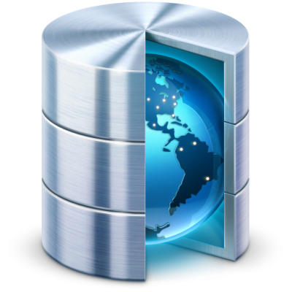
Today’s database world is an unhappy place for database administrators and software developers
You’re stuck between a rock and a hard place!

Slide 28
Either you use databases that offer enterprise capabilities but cost a fortune
Or you use open-source databases that are difficult to scale

Slide 29
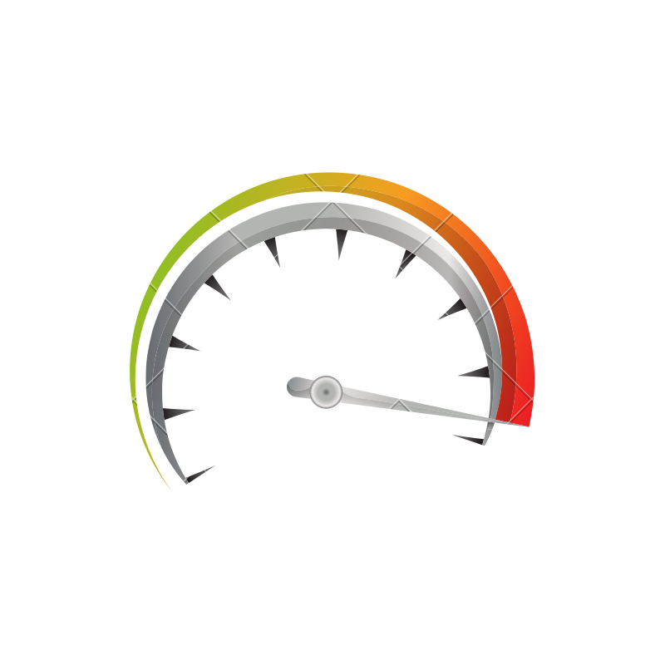
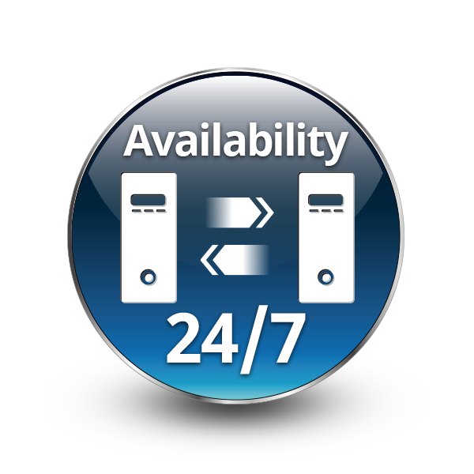

Free yourself and get the performance and availability of commercial databases with the low cost and flexibility of open source databases with Amazon Aurora
A relational database built for the cloud - Aurora is MySQL and PostgreSQL compatible, making it an easy choice for your new or existing applications
It’s up to 5 times faster than MySQL and up to 3 times faster than PostgreSQL and scales automatically to keep up with your applications
Aurora makes 6 copies of your data distributed across multiple locations and continuously backs it up to Amazon S3, so your data is safe !

Slide 30

For globally distributed applications, Aurora can replicate your data across multiple regions for fast local performance and disaster recovery

Slide 31

Enterprise Grade Performance
Aurora is fully managed so you can setup, operate and scale a database in the cloud with just a few clicks
For unpredictable workloads you can use Aurora Serverless to automatically start, scale and shutdown a database to match application demand
Aurora gives you -
Scalability
Availability
And Security
With the simplicity and cost effectiveness of an open source database

Slide 32
Move to the cloud, build faster and rent simpler with Amazon Aurora

Slide 33
Aurora Benefits
High performance and scalability
High availability and durability
Highly secure
MySQL and PostgreSQL compatible
Fully managed
Migration support

Slide 34
Aurora Use Cases
Enterprise Applications
Amazon Aurora is a great option for any enterprise application that can
use a relational database. Compared to commercial databases, Amazon
Aurora can help cut down your database costs by 90% or more while
improving reliability and availability of the database. Amazon Aurora being
a fully managed service helps you save time by automating time consuming
tasks such as provisioning, patching, backup, recovery, failure detection,
and repair.

Slide 35
Aurora Use Cases
Software as a Service (SaaS) Applications
SaaS applications often use architectures that are multi-tenant, which
requires a great deal of flexibility in instance and storage scaling along
with high performance and reliability. Amazon Aurora provides all of these
features in a managed database offering, helping SaaS companies focus
on building high quality applications without worrying about the underlying
database that powers the application

Slide 36
Aurora Use Cases
Web and Mobile Gaming
Web and mobile games that are built to operate at very large scale need
a database with high throughput, massive storage scalability, and high
availability. Amazon Aurora fulfills the needs of such highly demanding
applications with enough room for future growth. Since Amazon Aurora
does not have any licensing constraints, it perfectly fits the variable usage
pattern of these applications.

Slide 37







Featured Aurora Customers

Slide 38
Migrating Your Databases to Amazon Aurora
If you're currently using Amazon RDS for MySQL or Amazon RDS for
PostgreSQL...
If you're currently using Amazon RDS for MySQL or Amazon RDS for
PostgreSQL, migrating to Aurora is as simple as creating a snapshot and
launching an Aurora instance from that snapshot. You can follow the
simple, step by step instructions in the user guide to perform the migration.
Since Amazon Aurora is fully MySQL- and PostgreSQL-compatible, your
applications can easily be reconnected to the new instance without any
changes.
MySQL and PostgreSQL databases running on Amazon EC2 or on-premises
can also be easily migrated. Create a snapshot backup of your existing
database, upload it to Amazon S3, and use it to directly create an Amazon
Aurora cluster. You can also import data stored in an Amazon S3 bucket
into a table in an Amazon Aurora database. Standard MySQL import and
export tools or MySQL binlog replication are also supported. Migrating to
Amazon Aurora from supported databases running on Amazon EC2 or
on-premises can also be done using AWS Database Migration Service.

Slide 39
Migrating Your Databases to Amazon Aurora
If you're currently using Oracle or Microsoft SQL Server…
The AWS Schema Conversion Tool simplifies migration from Oracle and
Microsoft SQL Server to Amazon Aurora by automatically converting the
source database schema and a majority of the custom code - including
views, stored procedures, and functions - to a format compatible with
Amazon Aurora. Any code that cannot be automatically converted is
clearly marked so that it can be manually converted.
Migrating data from Oracle and Microsoft SQL Server databases to
Amazon Aurora can be easily done using AWS Database Migration Service.
You can begin a data migration with just a few clicks, and your source
database remains fully operational during the migration, minimising
downtime to applications using that database.

Slide 40
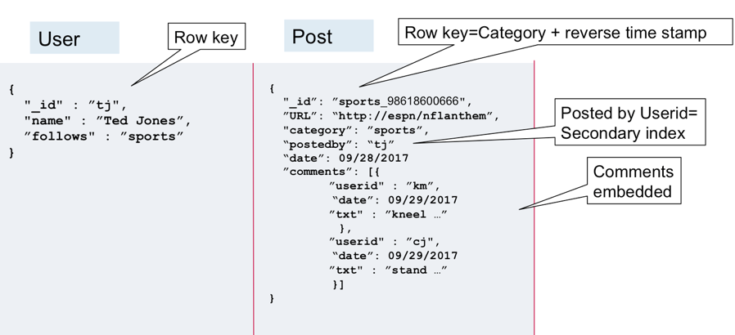

Slide 41
What is Data Warehousing?
Used for business intelligence. Tools like Cognos, Jaspersoft, SQL Server
Reporting Services, Oracle Hyperion, and SAP NetWeaver
Used to pull in very large and complex data sets. Usually used by
management to do queries on data (such as current performance
vs targets, etc)

Slide 42
OLTP vs OLAP
Online Transaction Processing (OLTP) differs from Online Analytics
Processing (OLAP) in terms of the types of queries you will run
OLTP example :
Order number 2120121
Pulls up a row of data such as Name, Date, Address to Deliver to,
Delivery Status, etc

Slide 43
OLAP
OLAP transaction example :
Net Profit for EMEA and Pacific for the Digital Radio Product
Pulls in large numbers of records
Sum of Radios Sold in EMEA
Sum of Radios Sold in Pacific
Unit Cost of Radio in each region
Sales price of each radio
Sales price - unit cost
Data Warehousing databases use different type of architecture both
from a database perspective and infrastructure layer

Slide 44
Automated Backups
There are two different types of Backups for AWS: Automated Backups
and Database Snapshots
Automated Backups allow you to recover your database to any point in
time within a ‘retention period’. The retention period can be between one
and 35 days. Automated Backups will take a full daily snapshot and will
also store transactional logs throughout the day. When you do a recovery,
AWS will first choose the most recent daily back up, and then apply
transactional logs relevant to that day. This allows you to do a point in time
recovery down to a second, within the retention period.

Slide 45
Automated Backups
Automated Backups are enabled by default. The backup data is stored in
S3 and you get free storage space equal to the size of your database. So,
if you have an RDS instance of 10GB, you will get 10GB worth of storage.
Backups are taken within a defined window. During the backup window,
storage I/O may be suspended while your data is being backed up and
you may experience elevated latency.

Slide 46
Snapshots
DB Snapshots are done manually (ie they are user initiated). They are
stored even after you delete the original RDS instance, unlike automated
backups.

Slide 47

Restoring Backups
Whenever you restore either an Automatic Backup or a manual
Snapshot, the restored version of the database will be a new RDS
instance with a new endpoint
original.ap-south-1.rds.amazonaws.com
restored.ap-south-1.rds.amazonaws.com

Slide 48
Encryption
Encryption at rest is supported for MySQL, Oracle, SQL Server, PostgreSQL,
MariaDB & Aurora. Encryption is done using the AWS Key Management
Service (KMS) service. Once your RDS instance is encrypted, the data
stored at rest in the underlying storage is encrypted, as are its automated
backups, read replicas, and snapshots
At the present time, encrypting an existing DB instance is not supported.
To use Amazon RDS encryption for an existing database, you must first
create a snapshot, make a copy of that snapshot and encrypt the copy.

Slide 49


What is a Multi-AZ?
AP-SOUTH-1A
AP-SOUTH-1B

Slide 50
What is Multi-AZ RDS?
Amazon RDS Multi-AZ deployments provide enhanced availability for
database instances within a single AWS Region. With Multi-AZ, your data is
synchronously replicated to a standby in a different Availability Zone (AZ).
In the event of an infrastructure failure, Amazon RDS performs an automatic
failover to the standby, minimising disruption to your applications.
Multi-AZ is for Disaster Recovery only
It is not primarily used for improving performance. For performance
improvement, you need Read Replicas

